Slide 1

Testing Session-2

Slide 2
Types of SDLC
Sequential model
Water fall model
V-V model
Incremental/Iterative model
Rapid Application Model(RAD)
Prototype model
Spiral model

Slide 3
Types of SDLC
Agile Model
Extreme Programming(XP)
DSDM(Dynamic System Development Method)
Kanban
Scrum
Crystal
FDD(Feature Driven Development)
Lean

Slide 4
Agile Model
What is Agile Methodology?
When we choose Agile model?
Scrum Methodology And It’s Working Progress
Scrum Frame Work
Agile Manifesto
Agile Principles

Slide 5
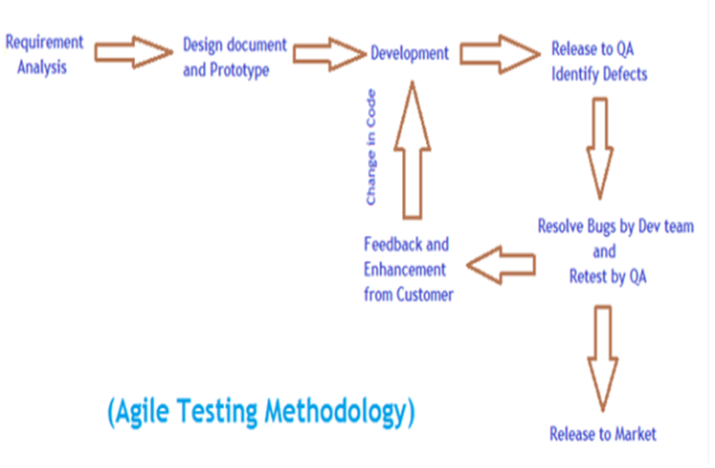

Slide 6
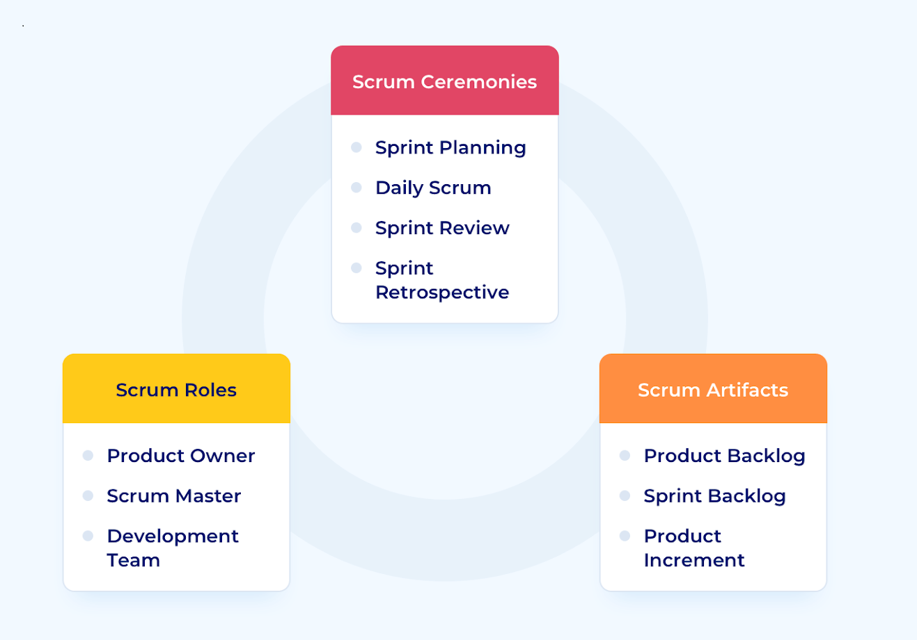
Scrum Methodology

Slide 7
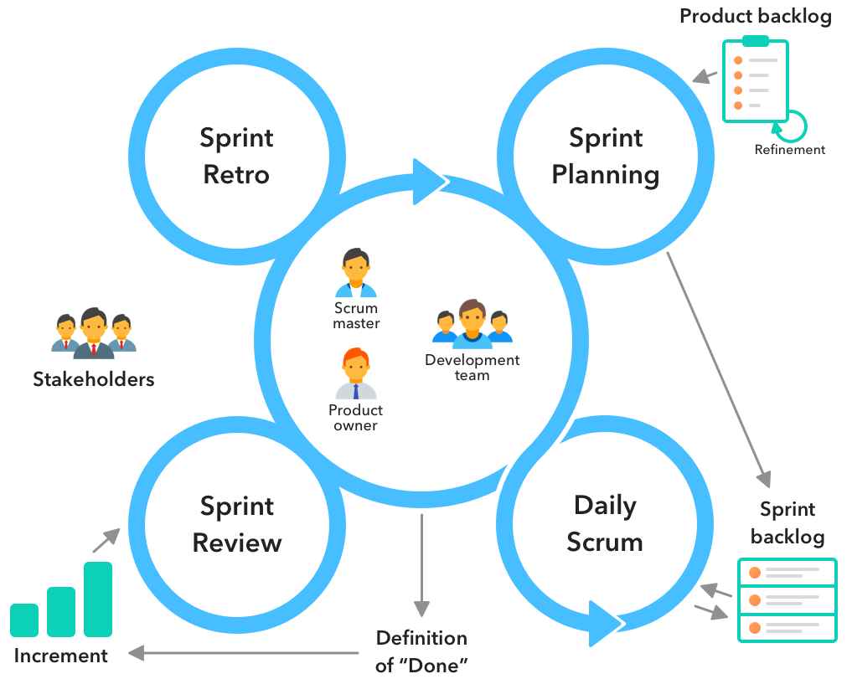
Scrum Methodology Working Progress

Slide 8
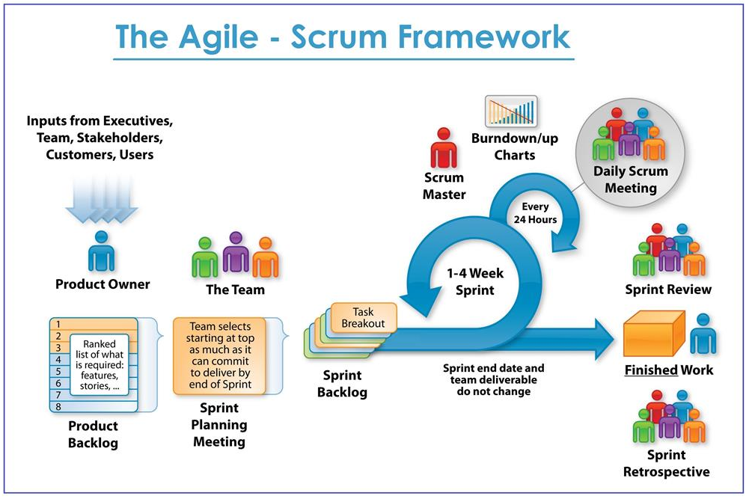

Slide 9
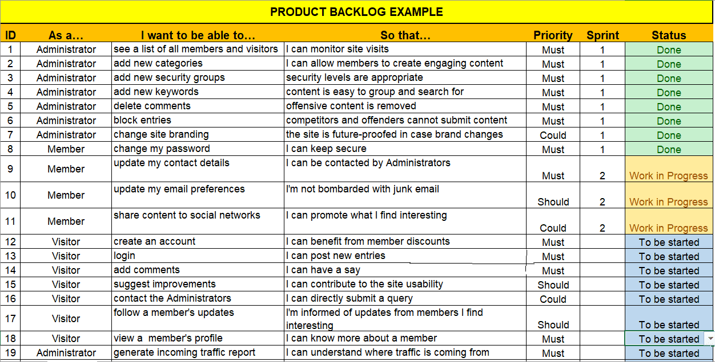

Slide 10
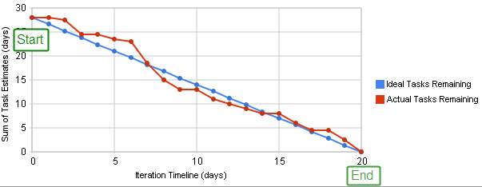
Scrum Burn Down Chart

Slide 11
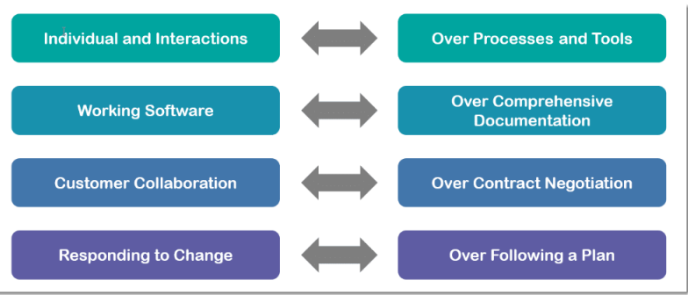
Agile Manifesto/Values

Slide 12
Agile Principles
1.Highest priority is to satisfy the customer. 2.Changes in requirements are Allowed. 3.Deliver working software frequently.
4.Continuous Interaction between Business people and Agile team.
5.Every Individuals Build the projects As responsible.
6.Self-organizing teams.
7.Agile team do prefer face-to-face conversation. 8.Working software is the primary object.
9.Able to maintain a constant working pace(40hours in a week). 10.Continuous attention to technical excellence. 11.Simplicity – the art of maximizing the amount of work not done – is essential. 12.The team reflects on how to become more effective.

Slide 13
Why Swhizz?
Follow the project-oriented training
One to One monitoring
Work on user stories
Expertise in resume preparation
Mock interviews
Job assistance
Real time people will deliver the classes
Hand on experience.
50+ Client connections for placement

Slide 14
Thank You
Mr.SubbaRao (Relationship Manager)
Contact:9059002244

